Slide 1
Brain Tumor Segmentation and Classification Using Image Processing
Md. Rakibul Islam Shanto
ID : 203-15-3871
AND
Samsun Naher Asme
ID : 203-15-3882
Department : CSE
Daffodil International University
Narayan Ranjan Chakraborty
Associate Head & Associate Professor
Department Of CSE
Daffodil International University

Slide 2
Outlines
Introduction
Motivation
Objectives
Research Gaps
Research Methods
Data Collection
Model Selections
Model Evaluation
Result Analysis
Application of the study
Limitations
Conclusion
References

Slide 3
Introduction
Major Health Threat Worldwide
Second Leading Cancer
Advances in MRI Imaging
Neural Networks and Deep Learning
Ongoing Research
Focus on Segmentation and Classification

Slide 4
Motivation
Defending the mistakes of diagnosis
Saving time and life
Helping early detection and early diagnosis

Slide 5
Objectives
Satisfying the patient
Giving professionals a friend
User friendly website

Slide 6
Research Gaps
Segmentation and Classification Together
Using of novel feature extraction
Redundancy of data by data augmentation
Graph Neural Network (GNNs) Implementation

Slide 7

Research Methods
Pre Processing – [25] Image Resizing, Feature Extraction
– [34] Grayscale conversion, Resizing
Segmentation – [20] CNN
– [ 7 ] CNN based U-Net
Classification – [25] ANN, KNN, SVM
– [38] ANN, KNN, DT, SVM, NB

Slide 8
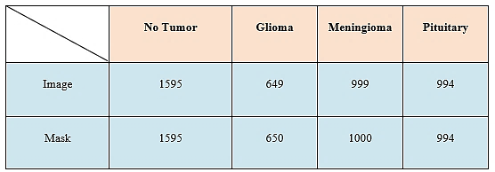
Data Collection
Kaggle Dataset
Four classes, a) No_Tumor, b) Glioma, c) Meningioma, d) Pituitary

Slide 9
Model Selections
Grayscale Conversion
Resizing
Feature Extraction
Thresholding
Pre-Processing
Segmentation
CNN (Convolution Neural Network)
LR, SVM,
DT, KNN, RF etc
ANN (Artificial Neural Network)
GNN (Graph Neural Network)
Classification

Slide 10
Model Evaluation
Segmentation
Image & Mask load
Resize, Grayscale
CNN Model Define
Train_test_split
Training & Testing
Calculate Result

Slide 11
Model Evaluation
Classification 1
Image load
Feature Extraction
Evaluate Model
Train ML Model
ANN Model Processing
Evaluation & Result

Slide 12
Model Evaluation
Classification 2
Load data
Create Graph
GNNNodeClassifier
GraphConvLayer
Testing
Confusion Matrics

Slide 13
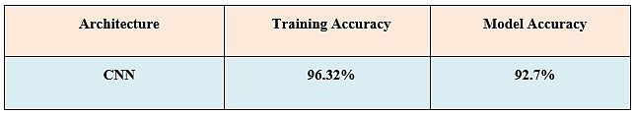
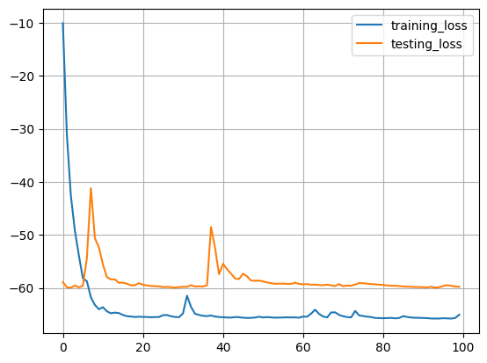
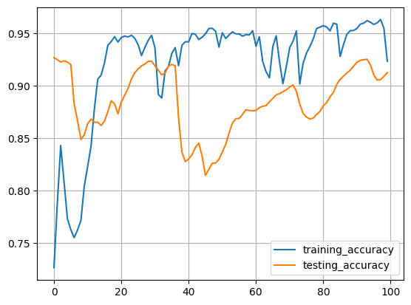
Result Analysis
Segmentation 1

Slide 14
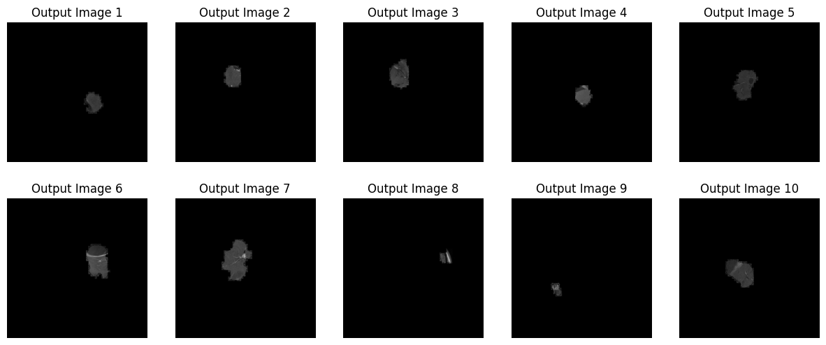
Result Analysis
Segmentation 2

Slide 15
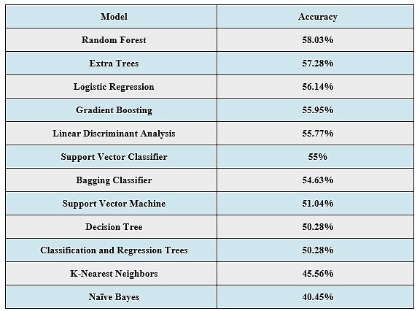
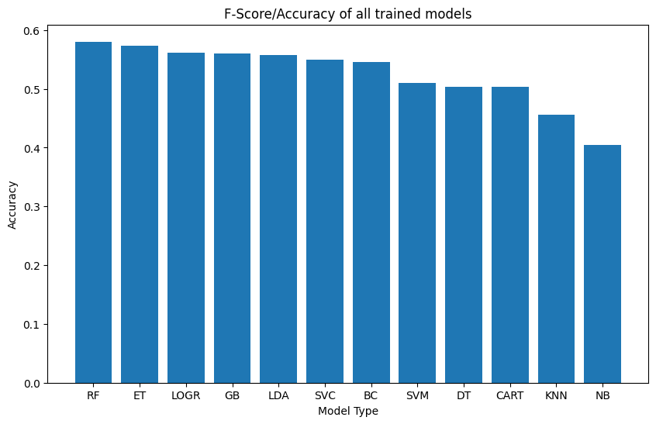
Result Analysis
Classification 1

Slide 16

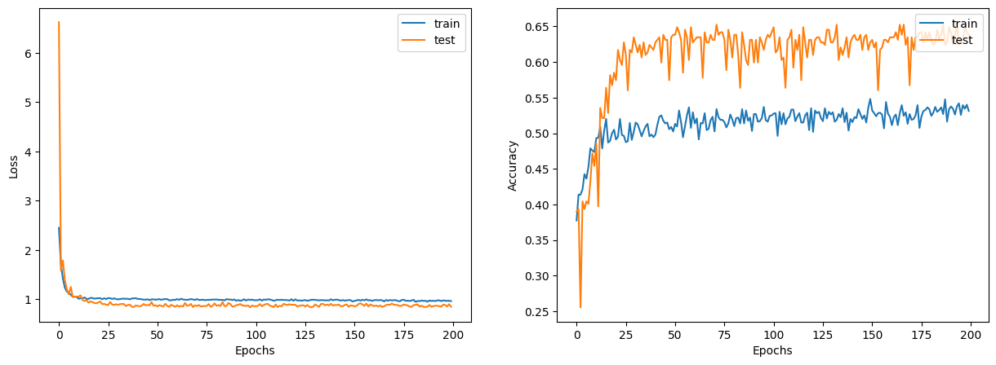
Result Analysis
Classification 2

Slide 17
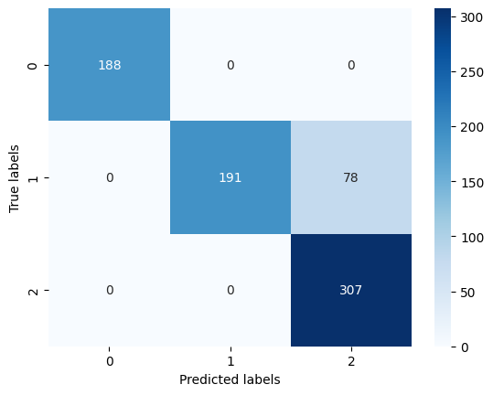

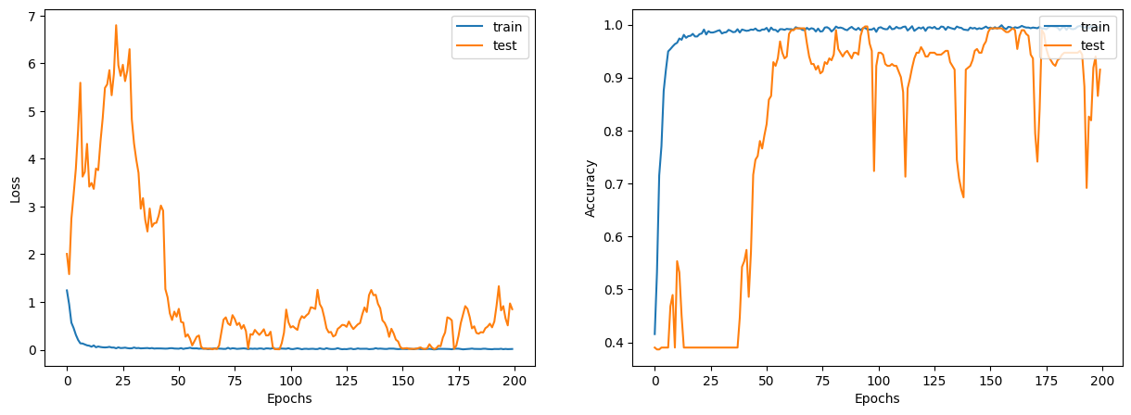
Result Analysis
Classification 3

Slide 18
Result Analysis

Slide 19
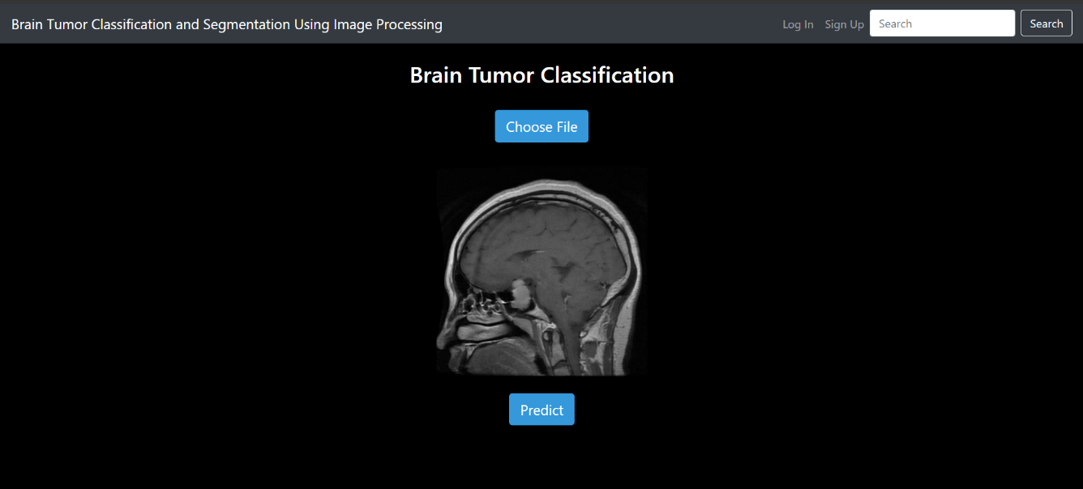
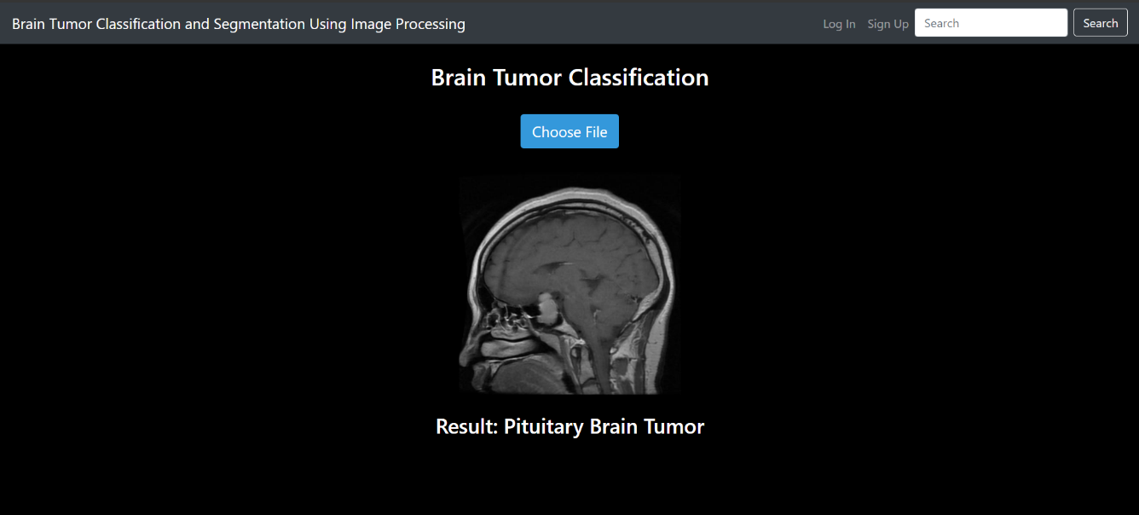
Application of the Study
Perfectly Detected Pituitary Tumor

Slide 20
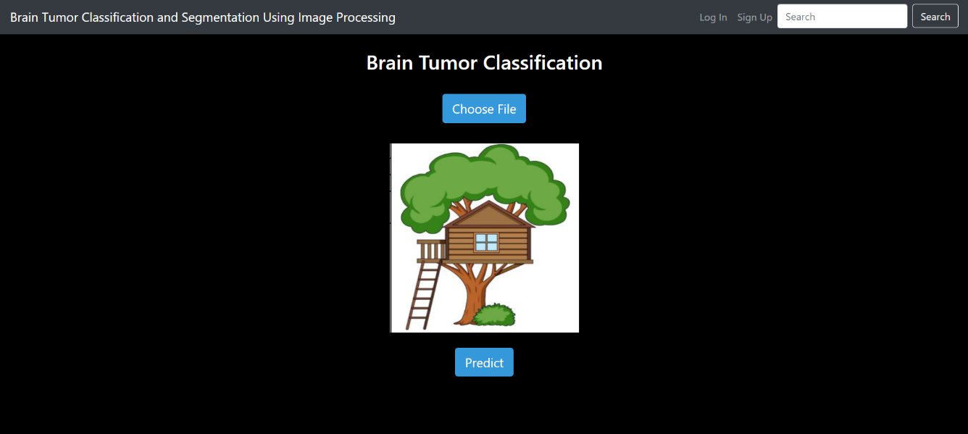
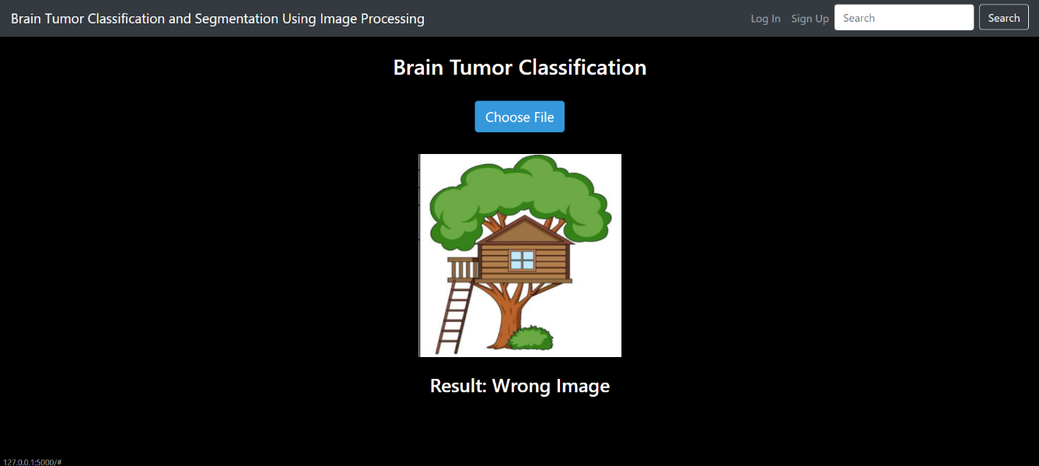
Application of the Study
Wrong Image Input Detection

Slide 21
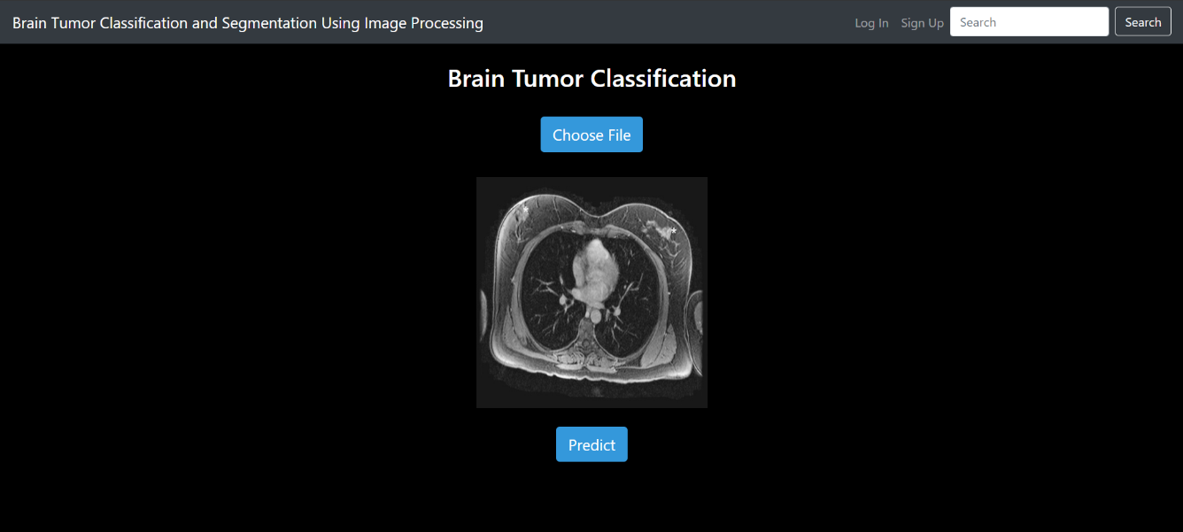
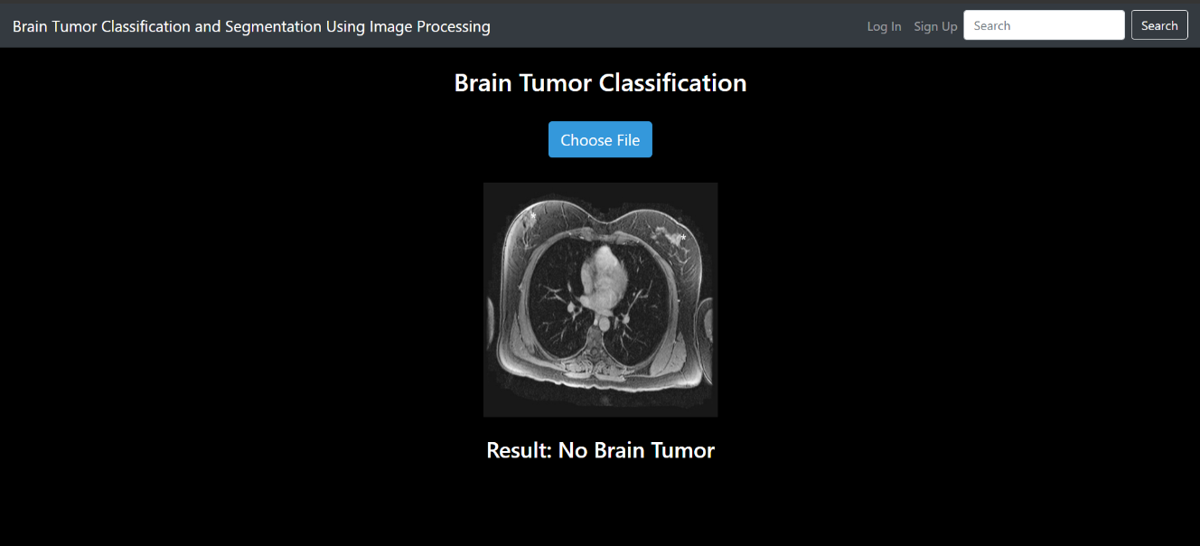
Application of the Study
Partially Detected

Slide 22
Limitations
Dataset Collection
Prediction of MRI Images Expect Brain
User Account
Personal Model
CT Scans

Slide 23
Conclusion
Brain Tumor
Segmentation and Classification
Top performing Model
Web Application
Limitations
Enhance Online Platform
Improve Segmentation Accuracy

Slide 24
References
[1] Methil, A.S., 2021, March. Brain tumor detection using deep learning and image processing. In 2021 international conference on artificial intelligence and smart systems (ICAIS) (pp. 100-108). IEEE.
[2] Sravanthi, N.S.R.D.N., Swetha, N., Devi, P.R., Rachana, S., Gothane, S. and Sateesh, N.J.I.J.S.R.C.S.E.I.T., 2021. Brain tumor detection using image processing. International Journal of Scientific Research in Computer Science, Engineering and Information Technology, 7(3), pp.348-352.
[3] Suresha, D., Jagadisha, N., Shrisha, H.S. and Kaushik, K.S., 2020, March. Detection of brain tumor using image processing. In 2020 Fourth International Conference on Computing Methodologies and Communication (ICCMC) (pp. 844-848). IEEE.
[4] Abd Khalid, N.E., Ismail, M.F., Manaf, M.A.A., Fadzil, A.F.A. and Ibrahim, S., 2020. MRI brain tumor segmentation: A forthright image processing approach. Bulletin of Electrical Engineering and Informatics, 9(3), pp.1024-1031.
[5] Grampurohit, S., Shalavadi, V., Dhotargavi, V.R., Kudari, M. and Jolad, S., 2020, October. Brain tumor detection using deep learning models. In 2020 IEEE India Council International Subsections Conference (INDISCON) (pp. 129-134). IEEE.
[6] Sahaai, M.B., 2021. Brain tumor detection using DNN algorithm. Turkish Journal of Computer and Mathematics Education (TURCOMAT), 12(11), pp.3338-3345.
[7] Jalali, V. and Kaur, D., 2020. A study of classification and feature extraction techniques for brain tumor detection. International Journal of Multimedia Information Retrieval, 9(4), pp.271-290..
[8] Amin, J., Sharif, M., Haldorai, A., Yasmin, M. and Nayak, R.S., 2022. Brain tumor detection and classification using machine learning: a comprehensive survey. Complex & intelligent systems, 8(4), pp.3161-3183.
[9] Kumar, S., Dhir, R. and Chaurasia, N., 2021, March. Brain Tumor Detection Analysis Using CNN: A Review. In 2021 International Conference on Artificial Intelligence and Smart Systems (ICAIS) (pp. 1061-1067). IEEE.
[10] Budati, A.K. and Katta, R.B., 2022. An automated brain tumor detection and classification from MRI images using machine learning technique s with IoT. Environment, Development and Sustainability, 24(9), pp.10570-10584.

Slide 25
THANK YOU

